Slide 1


By Jessica Everett

Slide 2
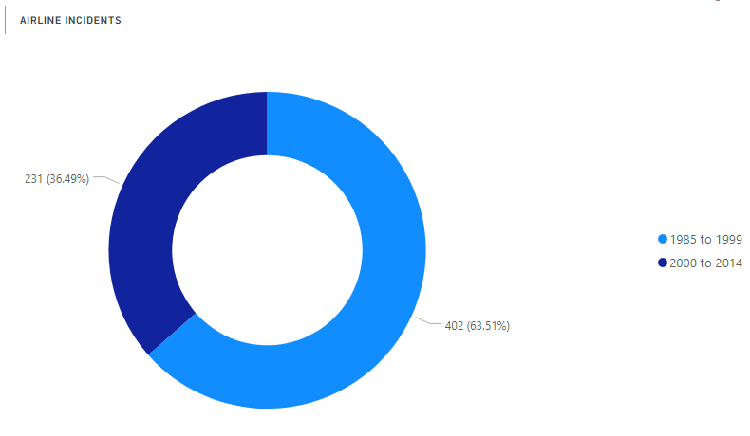
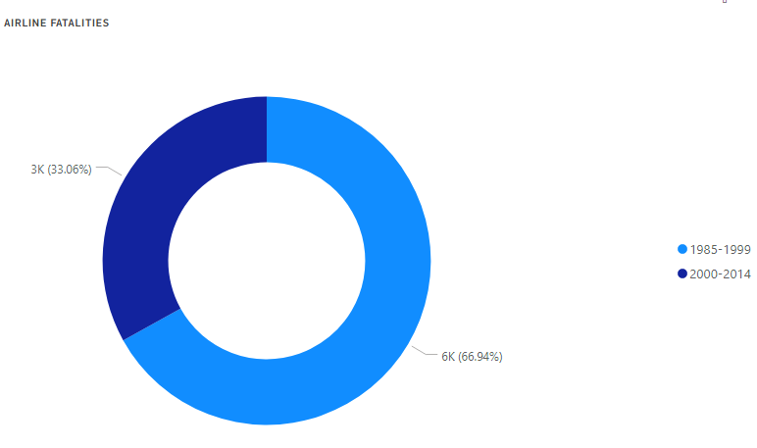
15 Year Comparison

Slide 3
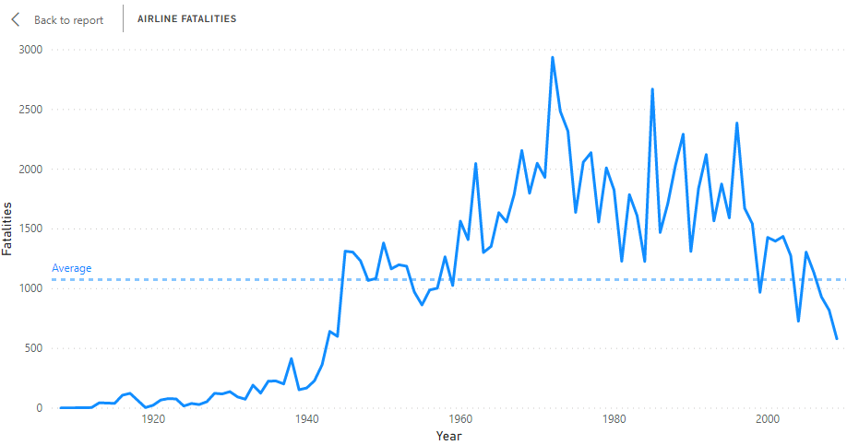
Fatalities Over Time
1972
2,373
1950
1,382
2009
581

Slide 4
References
References
Airline Safety. (2018). Retrieved from https://github.com/fivethirtyeight/data/tree/master/airline-safety
Airplane Crashes Since 1908. (2016). Retrieved from https://www.kaggle.com/saurograndi/airplane-crashes-since-1908/version/4#Airplane_Crashes_and_Fatalities_Since_1908.csv
Bomey, N. (2018). U.S. Vehicle Deaths Topped 40,000 in 2017, National Safety Council Estimates. Retrieved May 3, 2020, from https://www.usatoday.com/story/money/cars/2018/02/15/national-safety-council-traffic-deaths/340012002/
Rolph, C. (2019). The Safety of Airlines. Retrieved May 3, 2020, from https://blog.stafftraveler.com/aviation/airline-safety/
Schaper, D. (2020). Boeing 737 Max May Stay Grounded into Summer. Retrieved May 3, 2020, from https://www.npr.org/2020/01/21/798312515/boeing-737-max-may-stay-grounded-into-summer
Shepardson, D. (2018). 2017 Safest Year on Record for Commercial Passenger Air Travel. Retrieved May 3, 2020, from https://www.reuters.com/article/us-aviation-safety/2017-safest-year-on-record-for-commercial-passenger-air-travel-groups-idUSKBN1EQ17L
System Total Operating Revenue. (n.d.). Retrieved from http://web.mit.edu/airlinedata/www/Revenue&Related.html
The Year of Flying Dangerously: 1972. (2017). Retrieved May 3, 2020, from https://www.flightsafetyaustralia.com/2017/01/the-year-of-flying-dangerously-1972/

